Slide 1


FABI Mobile
To push research to the edge.

Slide 2
Table of Contents
Team
Overview
Management Tools
Problems to Solve
Proposed Solution
Use Case
Unit Testing
Integration Testing
Live Demo

Slide 3
Team Responsibilities
Team Leader and Front-End Developer
Project Management setup
Organization Information Subsystem
Logging Subsystem
Quality Requirements
Mockups
Web-App Design
Front-End Developer
User Characteristics
Traceability Matrix
Administration Subsystem
Reporting Subsystem
Domain Model
Web-App Markup
Unit Testing
Tegan
Emma

Slide 4
Team Responsibilities
Back-End Developer
Central Data Access Point Handler Subsystem
Porting Subsystem
Web-App API integration
Aeron
Back-End Developer
FABI Internal Form Handler Subsystem
Notification Subsystem
Web-App Front-End Logic
Travis CI Integration
Luveshan
Back-End Developer
Team Landing Page
Authentication Subsystem
Diagnostic Clinic Handler Subsystem
Sample Tracking Subsystem
Quality Requirements
API Setup and hosting
Database Management
Kendra

Slide 5




Agile Development Process
Individuals and Interactions
Working Software
Customer Collaboration
Responding to Change

Slide 6
Project Description
FABI would like us to implement a new database management system as well as both a mobile and web application. A central manager will therefore also need to be created to manage all of the databases. Due to the sensitive nature of their data, a user management system will also need to built to provide mandatory access control (MAC). The mobile and web applications will provide similar functionality, however, the web application will primarily cater for all administrative tasks. The mobile application will mainly be used by FABI’s clients (forestry organizations) to submit a diagnostic clinic sample form as well as send images of the sample that they are submitting.

Slide 7



Project Management Tools
GitHub
Trello
Slack

Slide 8
Problems To Solve
Scattered Databases
1
Paper Based Systems and Excel Spreadsheets
2
Non-functioning Diagnostic Clinic
3
No User Management System
4

Slide 9
Functional Requirements Overview
Create a centralised database manager
1
Create a user management system
2
Create a web application
3
Create a mobile application
4

Slide 10

Project Solution
Centralised Databases and Automated Processes

Slide 11
Quality Requirements
Scalability
Extensibility
Performance
Security
Interface
Availability
Capacity
Recoverability
Maintainability
Integrity
Usability
Interoperability

Slide 12
Unit Testing
1
Angular spec files
2
Jasmine: a framework provided by Angular to create tests
3
Karma: a task runner provided by Angular for the tests.

Slide 13
Integration Testing
1
Travis CI
2
Automated
3
Runs before deployment is successful

Slide 14
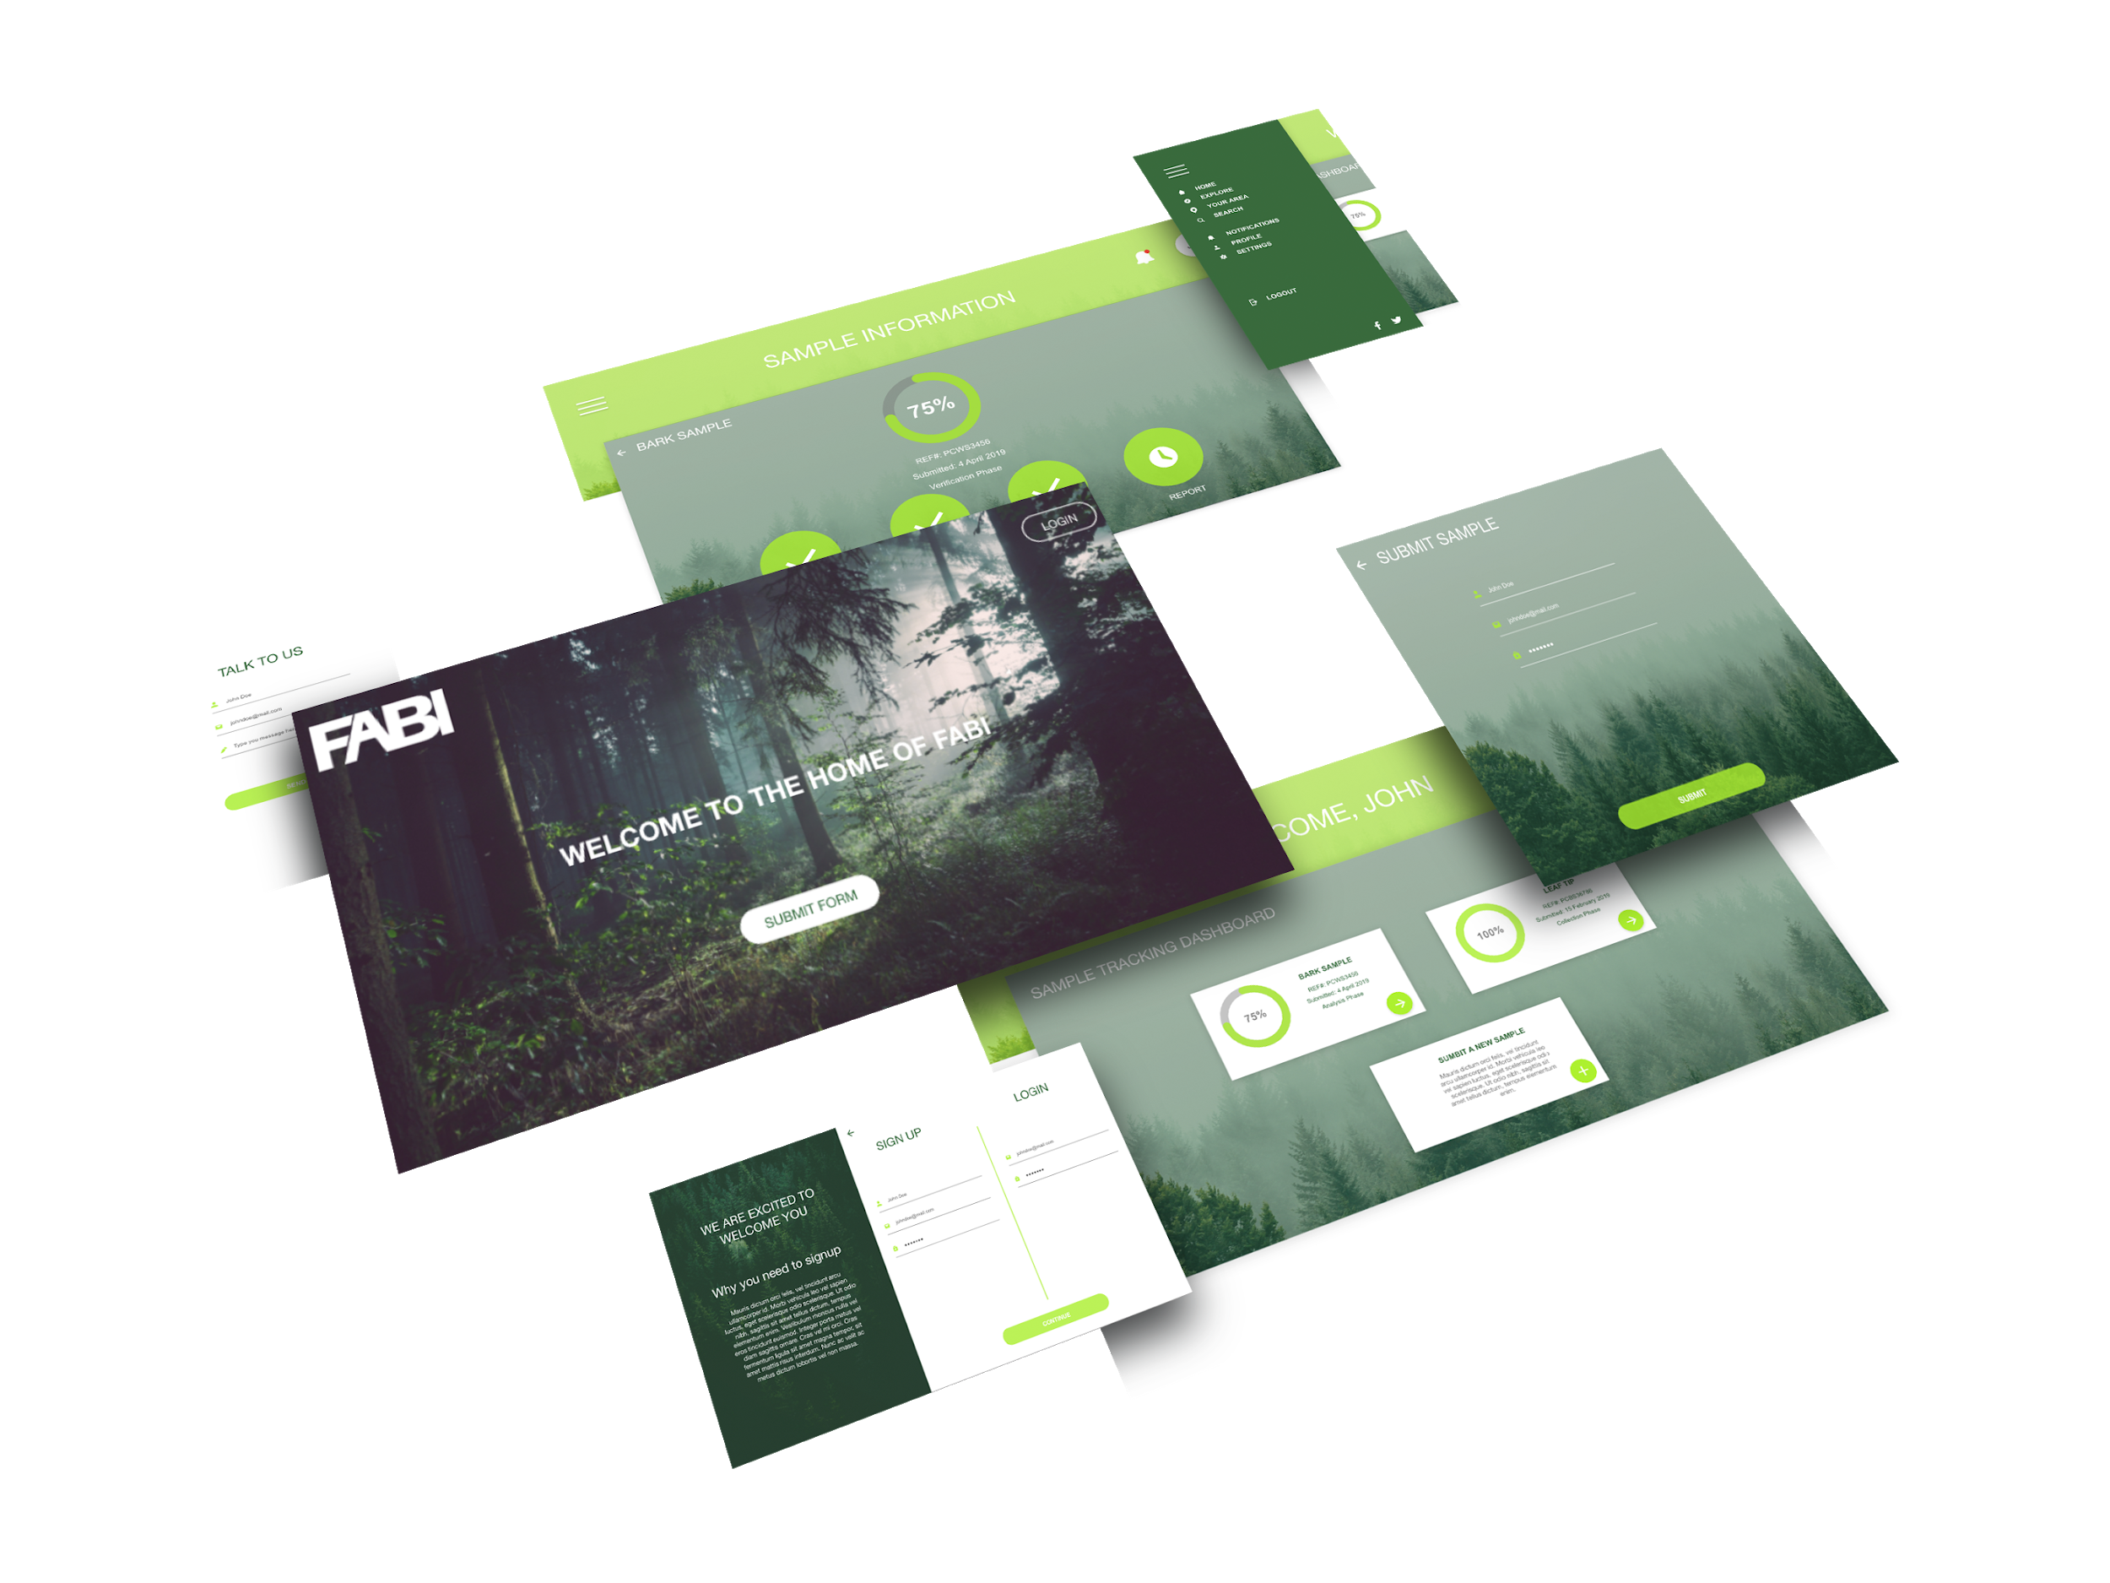
Web Mockup

Slide 15
Implemented Use Cases
Create Organization Account
Authenticate Public User Login
Submit Sample Form
Send Sample Reference Number
Log Authentication Details
Live Demo

Slide 16
THE END

